Slide 1

Introduction to Python
Mickael BOLNET – Python Instructor
1

Slide 2
Introduction to Python
Table of contents



Some variables …
… and some functions
Use ext. modules
1
2
3
4
5
6
7
What is coding ?
… an algo …
Organize your code
Test & Debug



⇧
2

Slide 3
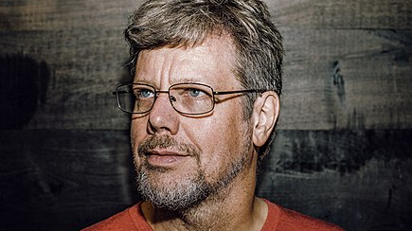
Guido Van Rossum
Creator Of Python - since 1989
From the Netherlands
Python version 1.0 - 1991
Python Version 2.0 - 2000…2015 (err… 2020)
Python version 3.0 - 2008
3

Slide 4
How does it work ?
Memory
Memory
Like in a human being memory is a important part of a computer.
This is where the code describing what the computer should do
Is stored. And this is where data is stored.

Processing Unit
One or many processing units execute the code.
There are many types of processors.
CPU / GPU / TPU
Processing
Unit
Périphériques
Peripherals allows the system to interact with the world.
Keyboard, Screen, mouse, network…

Peripherals

4
4

Slide 5
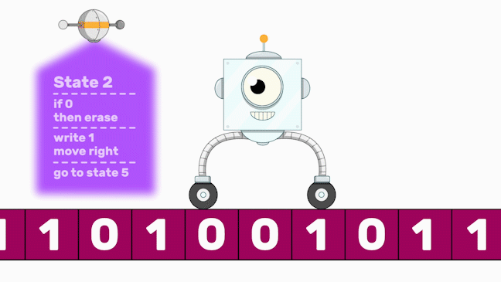
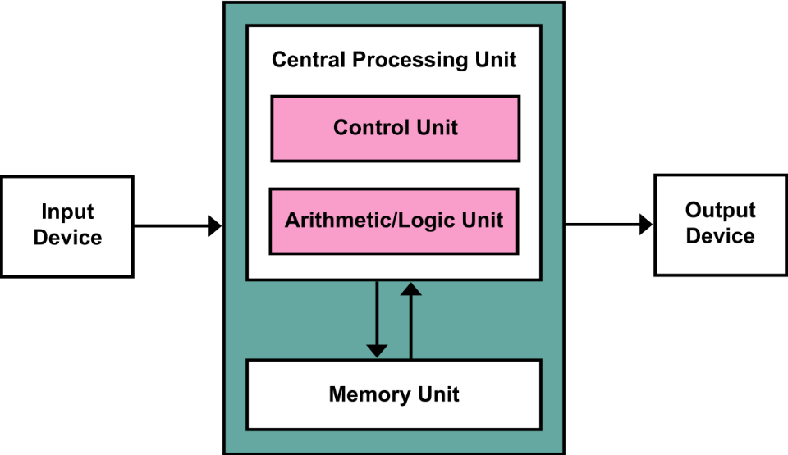
How does it work ?
Turing Machine
Von Neumann Architecture
5

Slide 6
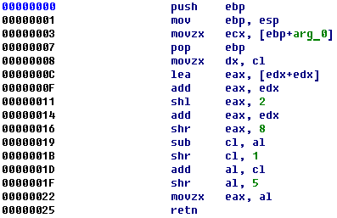
How does it work ?
Everything start with the l’assembly…
6

Slide 7
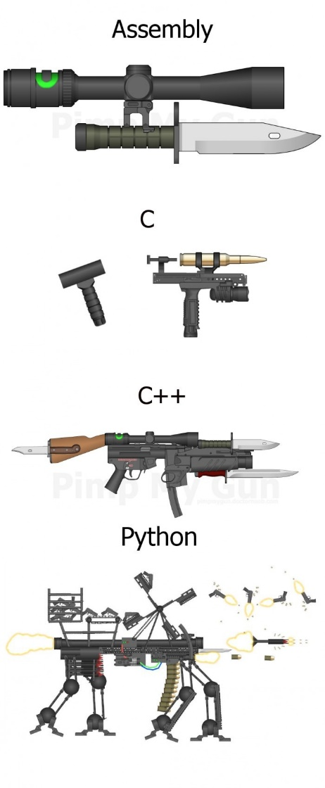
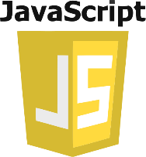




Python in comparison
ASM
7

Slide 8





Python use cases
8

Slide 9
Some variables



Some variables …
… and some functions
Use ext. modules
1
2
3
4
5
6
7
What is coding ?
… an algo …
Organize your code
Test & Debug



⇧
9

Slide 10
Variables
Variables, naming conventions, types (dynamic types), sequences
a = 10 # 10 → a
b = 11 # 11 → b
print(a) # display the content of a
print("a") # display the character "a"
print(b) # display the content of b
print(a + b) # display the result of an operation
print("a + b") # display the string "a+b"
10
a
b
11
10

Slide 11
Variables
Variables, naming conventions, types (dynamic types), sequences
a = 10 # 10 → a
print(type(a)) # display the type of variable a
a = "hello" # "hello"→ a
print(type(a)) # display the type of variable a
a = True # True → a
print(type(a)) # display the type of variable a
a
Puis…
"bonjour"
a
10
11
type(a) → int
type(a) → str

Slide 12
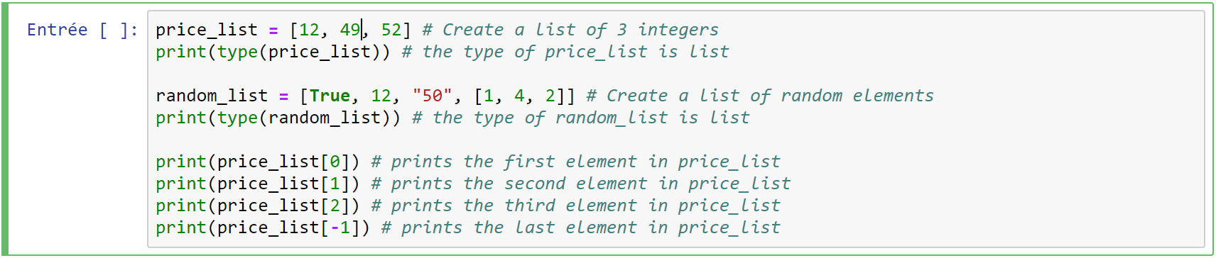
Variables
Lists
12
43
50
0
1
2
12

Slide 13
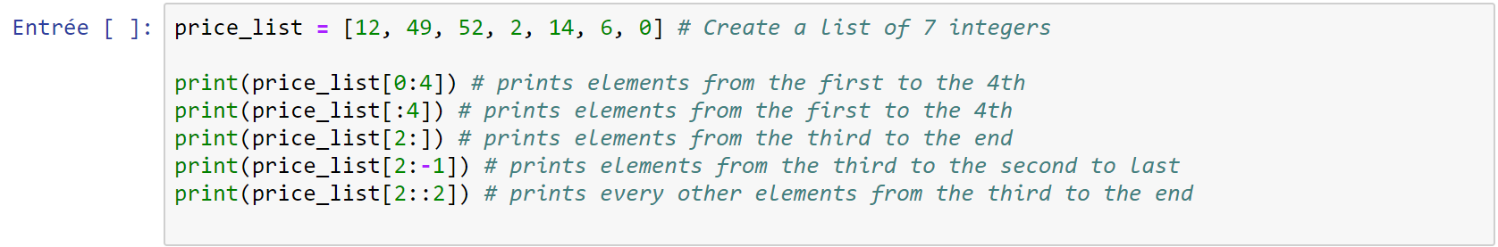
Variables
Lists
13

Slide 14
Variables
Dictionary
"Bol"
43
"ok"
nom
age
4
14

Slide 15
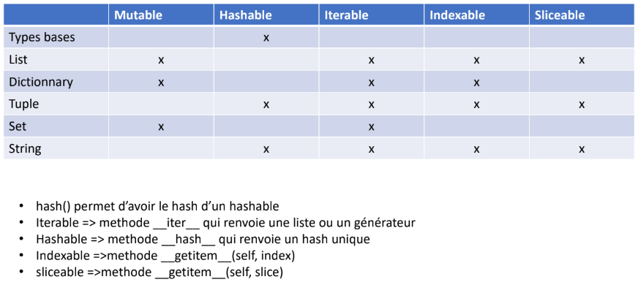
Variables
Hash() return the hash of an hashable
In order to define an iterable one should define the method __iter__ which returns a list or a generator
In order to define an hashable one should define the method __hash__ which returns an unique hash
In order to define an indexable one should define the method __getitem__(self,idx)
In order to define an sliceable one should define the method __getitem__(self,slice)
15

Slide 16
Les variables
Operations on integer, float and complex
x + y | Addition
x - y | Soustraction
x * y | Multiplication
x / y | Division
x // y | Euclidian Division
x % y | Remainder
-x
+x
x ** y | Power
16

Slide 17
Les variables
Operation on sequences
x not in s | False if s contains x, else True
s1 + s2 | Concatenation
s * n | Repeat
s[i] | The i-th element
len(s) | Sequence length
min(s) | Smallest element in seq
max(s) | Biggest element in seq
s.index(x) | Index of x’s first occurence
s.count(x) | Number of x’s occurrences
17

Slide 18
An Algo…
How to build an algo ?



Some variables …
… and some functions
Use ext. modules
1
2
3
4
5
6
7
What is coding ?
… an algo …
Organize your code
Test & Debug



⇧
18

Slide 19
An algo
WHILE loop
nb = 7
i = 0
while i < 10:
print(i + 1, "*", nb, "=", (i + 1) * nb)
i += 1
❑ Beware : indentation required!
19

Slide 20
An algo
FOR loop
for i in range(5):
print(i)
for i in range(3, 6):
print(i)
for i in range(4, 10, 2):
print(i)
for i in range(0, -10, -2):
print(i)
20

Slide 21
An algo
Conditionnal structure
name = 'Mickael'
if name == 'Mickael':
print(‘Hello Mickael')
elif name == 'Laetitia':
print(‘Hello Laetitia')
else:
print(‘’You can’t get inside ’’)
❑ Beware double "=" !!
21

Slide 22
An algo
Comparison operators
< | Less than
> | Greater than
<= | Less or equal
>= | Greater or equal
== | Equal
!= | Different
22

Slide 23
An algo
Combining operators
or
not
and
23

Slide 24
An algo
Time for Fizz Buzz !!
24

Slide 25
Another example of algorithm
Bubble sort
25

Slide 26
Inputs and templates
Interact with user
name = input(" What is your name ? ")
age = int(input(" How old are you ? ")) # cast string value to int
" Variable : %type" % var
" Variables : %type, %type" % (var1, var2)
"Result : %(val)type %(unit)type" % {'val':var1, 'unit':var2}
type is d : integer - f : float - s : string - c : character - o : octal - x : hexadecimal
Precision pour float :
"Result: %.2f" % 3.141592653589793
26

Slide 27
F-string for python 3
Interact with user
name = input(" What is your name ? ")
age = int(input(" How old are you ? "))
print(f" Je m’appelle {name} et j’ai {age} ans" )
27

Slide 28
Dichotomy search
28

Slide 29
Functions
Definition vs Execution
def say_hi():
print(‘Hello world!’)
say_hi() #’Hello world!'
29

Slide 30
Functions
Parameters
def say_hi():
print(‘Hello world!')
def say_hi(name):
print(' Hello ' + name)
def say_hi(name, name2='', name3='toto'):
print('Hello ' + name + ' ' + name2)
30

Slide 31
Functions
Portée des variables (local vs global)
foo = 1
def test_local():
foo = 2 # new local foo
def test_global():
global foo
foo = 3 # changes the value of the global foo
31

Slide 32
Functions
Board display
32

Slide 33
External modules
Pip, parenthèse environnement, Selenium
Install modules in the command line interface
pip install selenium
Create a list of installed external modules
pip freeze > requirements.txt
Install a list of external modules
pip install –r requirements.txt
Create a virtual env
virtualenv monenv
Activate / Deactivate environment
monenv/Scripts/activate
deactivate
33

Slide 34
External modules
Example with Selenium
34

Slide 35
Organize your code
Packages & Modules
Starts with:
#!/usr/bin/env python
# -*- coding: utf-8 -*-
Contains __init__.py :
MyPackage/
__init__.py
MyModule.py
MyModule2.py
__all__ = [ 'MyModule', 'MyModule2']
35

Slide 36
Organize you code
Packages & Modules
import MyModuleLibrary.MyModule
import MyModuleLibrary.MyModule2
MyModuleLibrary.MyModule.function_welcome()
MyModuleLibrary.MyModule2.function_welcome_bis()
36

Slide 37
Package your module
Packages & Modules
setup.py
src/
mypkg/
__init__.py
module.py
data/
tables.dat
spoons.dat
forks.dat
37

Slide 38
Package your module
Packages & Modules
#!/usr/bin/env python
from distutils.core import setup
setup(name=‘MonPackage',
version='1.0',
description=‘Package that says hello in several languages',
author=‘Mickael BOLNET',
author_email=‘mickael.bolnet@web-n-data.com’,
packages=[‘MonPackage’],
requires=[‘numpy’],
package_dir={'MonPackage': 'src/MonPackage'},
package_data={'MonPackage': ['data/*.dat']},
)
38

Slide 39
Get arguments from cmdline
Argparse
parser = argparse.ArgumentParser(
description="This script does something.")
parser.add_argument("who", help="Who are you ?")
parser.add_argument("-m","--many", type=int)
args = parser.parse_args()
for i in range(args.many):
print("Hello " + args.who)
39

Slide 40
Test & Debug
def add(a, b):
"""
:Example:
>>> add(1, 1)
2
>>> add(2.1, 3.4)
5.5
"""
return a + b
if __name__ == "__main__":
import doctest
doctest.testmod()
40

Slide 41
Test & Debug
import unittest
from training.poo.bank import bank
class TestDeposit(unittest.TestCase):
def setUp(self):
self.account = bank.BankAccount('012345', 500)
def testBasicDeposit(self):
self.account.deposit(100)
self.assertEqual(600, self.account.balance())
def tearDown(self):
del self.account
41

Slide 42
Test & Debug
l : (list) list some line of code around
n : (next) execute next line
s : (step in) get inside function execution
r : (return) get outside function execution
unt : (until) execute a loop untill the end
q : (quit) quit program execution
c : (continue) continue untill next breakpoint
42

Slide 43
OOP
Sphynx & reStructuredText
43

Slide 44
OOP
Object Oriented Programming
44

Slide 45
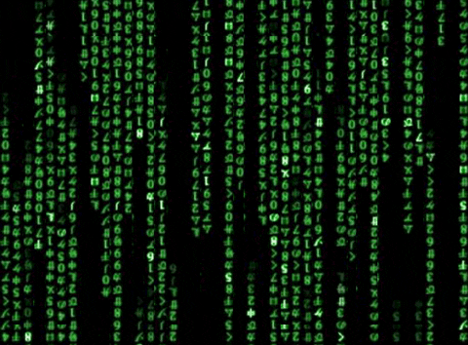


OOP
Avoid long linear code
Allow global understanding
Split responsabilities
Working together
45

Slide 46
OOP
An object is defined by
Its states -> attributes
Its behaviours -> methods
46

Slide 47
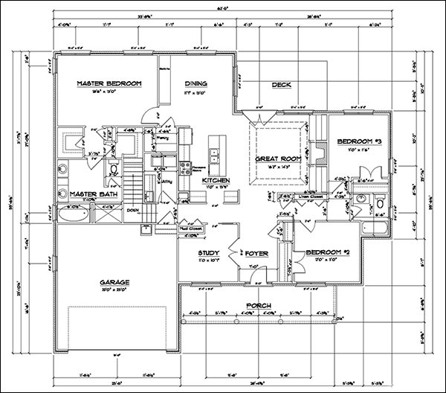

Class vs Instance
Classes are blueprints
Instances are real
47

Slide 48
OOP
class Person:
"""Class that define a person by:
- its firstname
- its lastname
- its age
- its location"""
def __init__(self):
""" The constructor describe how to build each instance. So far every person have the same characteritics """
self.firstname = "John"
self.lastname = "Smith"
self.age = 33
self.location = "Paris"
48

Slide 49
OOP
person= Person()
print(person.firstname)
49

Slide 50
OOP
class Person:
"""Class that define a person by:
- its firstname
- its lastname
- its age
- its location"""
def __init__(self, firstname, lastname="John", age=32):
""" The constructor describe how to build each instance. So far every person have the same characteritics """
self.firstname = firstname
self.lastname = lastname
self.age = age
self.location = "Paris"
Attention à ne PAS OUBLIER self !
50

Slide 51
OOP
person= Person("Martin","Jean")
print(person.firstname)
51

Slide 52
OOP
class Person:
"""Class that define a person by:
- its firstname
- its lastname
- its age
- its location"""
nb_person = 0 # initialize a class attribute (common for every Person)
def __init__(self, firstname, lastname="John", age=32):
""" The constructor describe how to build each instance. So far every person have the same characteritics """
self.firstname = firstname
self.lastname = lastname
self.age = age
self.location = "Paris"
Person.nb_person += 1 # add one to nb_person every time we create a new instance
Attention à ne PAS OUBLIER self !
52

Slide 53
Special methods
__init__(self) : initializer, called after instance creation
__del__(self) : destructor called before instance destruction
__str__(self) -> str : Is called to convert instance to string (i.e. for print or str cast). It must return a string
Attention à ne PAS OUBLIER self !
53

Slide 54
Special methods
Method | Operator
__lt__(self, other) | x < y
__le__(self, other) | x <= y
__eq__(self, other) | x == y
__ne__(self, other) | x != y
__ge__(self, other) | x >= y
__gt__(self, other) | x > y
54

Slide 55
Special methods
Method | Operator
__neg__ | -x
__add__ | x + y
__sub__ | x - y
__mul__ | x * y
__div__ | x / y
55

Slide 56
OOP
Avoid long linear code
Allow global understanding
Split responsabilities
Working together
56

Slide 57
OOP
An object should be a black box
Only the developer in charge knows what is inside
Make internal changes independant from external use
Manage complexity internally
More robust development
Split responsabilities
Working together
57

Slide 58
Inheritance
58

Slide 59
Inheritance
class Client(Personne):
"""Classe définissant une personne caractérisée par :
- son nom
- son prénom
- son âge
- son lieu de résidence"""
def __init__(self):
"""Pour l'instant, on ne va définir qu'un seul attribut"""
Personne.__init__(self)
59

Slide 60
FIN
60

Slide 61
Some Code
61

